Slide 1

A Strategy for Label Alignment in Deep Neural Networks
Authors:
Xuanrui Zeng
Paper link: https://arxiv.org/abs/2410.04722 Published date: Oct 2024
Vishali Dharmaram
ID:700762267

Slide 2
Contents
Motivation
Problem Statement
Objectives
Main Idea (Contributions)
Results
References

Slide 3
Motivation
Unsupervised Domain Adaptation (UDA) faces significant challenges due to distribution differences between source and target domains.
Ordinary models trained on labeled source data fail to adapt well to unlabeled target data.
A new approach is needed to align labels for improved deep neural network adaptation.
Challenge: Domain adaptation without target labels often leads to distribution mismatch, making it hard for models trained on source data to generalize to target data.
Prior Work: Builds on earlier work by Imani et al., which used label alignment in linear models. This paper extends that concept to deep neural networks.

Slide 4
Problem Statement
Unsupervised domain adaptation requires models trained on labeled source domains to adapt to target domains without labels.
The challenge lies in the distribution difference between source and target domains, where models fail to learn domain-invariant representation.
Ordinary models do not adapt well when faced with this distribution shift.
Core Issue: Adapting models trained on labeled source data to perform well on unlabeled target data where domain shifts occur.
Domain Adaptation: Traditional methods focus on making features domain-invariant, but label alignment offers an alternative path, aiming to adjust the model to align with the target domain’s feature distribution.

Slide 5
Objectives
Primary Goal: Develop a label alignment strategy for deep neural networks to improve domain adaptation performance.
Extending the concept of label alignment from linear regression to deep neural networks.
Propose a novel algorithm that uses label alignment to improve unsupervised domain adaptation.
Demonstrate that the new method achieves comparable performance to mainstream approaches like ADDA (Adversarial Discriminative Domain Adaptation) and DANN (Domain-Adversarial Neural Network).

Slide 6
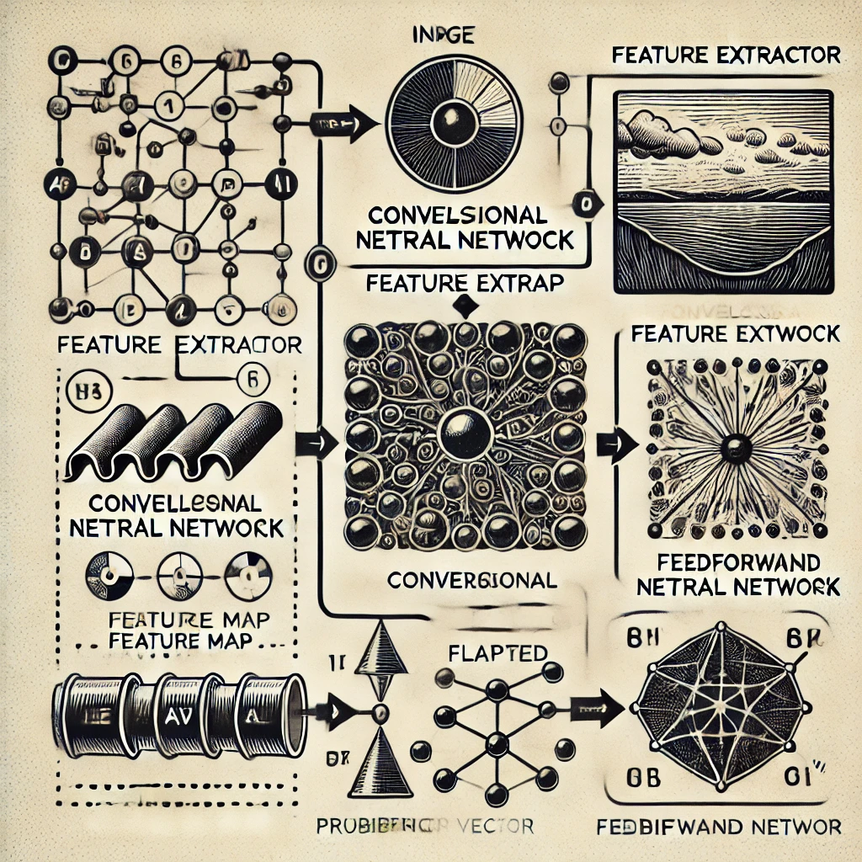
Contributions
Generalized the label alignment technique to deep neural networks for unsupervised domain adaptation.
Proposed a new algorithm that exploits dimensionality reduction in deep networks for better adaptation.
Conducted experiments demonstrating stable convergence and performance comparable to other popular methods like ADDA and DANN.

Slide 7
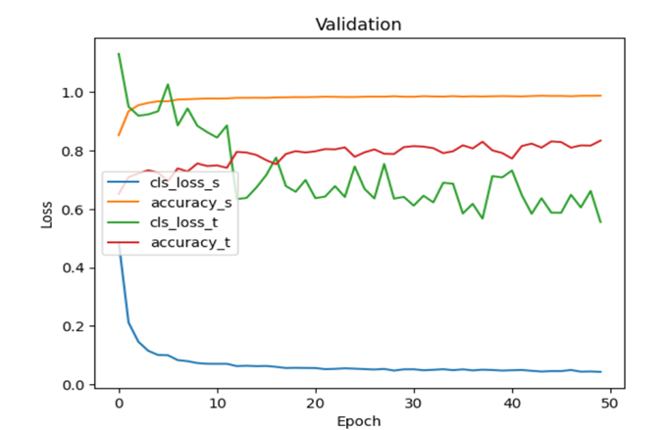
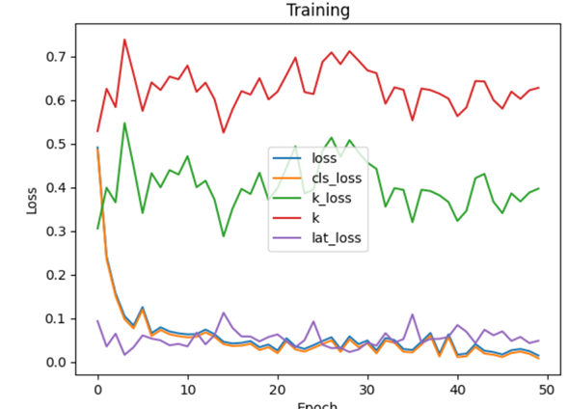
Results
Achieved stable convergence in comparison to ADDA and DANN.
Accuracy: 79.14% for DLA (Deep Label Alignment) compared to 78.80% for ADDA and 78.95% for DANN.
Demonstrated improved stability in the training curve, reducing adversarial instability common in other methods.

Slide 8
Critical Analysis
Strengths:
Achieved stable convergence, overcoming instability issues seen in adversarial methods.
Effective for unsupervised domain adaptation using label alignment.
Limitations :
Assumes source and target label alignment ranks are similar, which may not hold universally.
Requires more rigorous theoretical proofs.
Future Work:
Expand evaluation to different datasets and tasks.
Investigate potential as a regularization method for supervised learning.

Slide 9
References
Ganin, Y., & Lempitsky, V. (2015). Unsupervised domain adaptation by backpropagation.
Imani, E., Hu, W., & White, M. (2021). Understanding feature transfer through representation alignment.
Imani, E., et al. (2022). Label alignment regularization for distribution shift.
Shlens, J. (2014). A tutorial on principal component analysis.
Tzeng, E., et al. (2017). Adversarial discriminative domain adaptation.
Xuanrui Zeng, 'A Strategy for Label Alignment in Deep Neural Networks,' University of Waterloo, 2024.

Slide 10
THANK YOU

